Slide 1




Data Lakehouse
(What is it?)

Slide 2
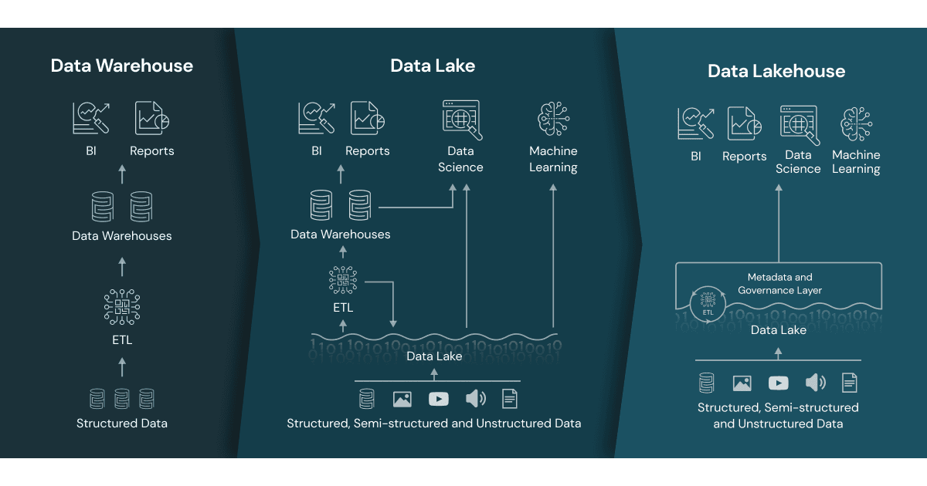

Data Lakehouse
A data lakehouse provides scalable storage and processing capabilities for modern organizations that want to avoid isolated systems for processing different workloads, like machine learning (ML) and business intelligence (BI).
A data lakehouse is a modern data management architecture that combines the best features of data lakes and data warehouses. It provides the scalability and flexibility of data lakes with the data management and transactional capabilities of data warehouse
A data lakehouse can help establish a single source of truth, eliminate redundant costs, and ensure data freshness.
Data lakehouse leverages ADLS for storage while adding robust data management features through Delta Lake, creating a powerful and efficient data platform for various analytics and machine learning workloads.
Delta Lake Integration
Notes:
Storage Foundation: ADLS serves as the underlying storage layer for a data lakehouse. It provides the scalable and cost-effective storage needed to hold large volumes of data.
Delta Lake Integration: On top of ADLS, Delta Lake is often used to add data management capabilities. Delta Lake provides ACID transactions, schema enforcement, and other data management features that enhance the reliability and performance of the data lakehouse.
Unified Data Access: The data lakehouse architecture allows users to access and analyze data stored in ADLS using a single platform, simplifying data workflows and reducing the need for multiple systems
Delta Lake can be considered a bridge between traditional data lakes and data warehouses. By adding data warehouse-like management capabilities to data lakes (like ACID transactions and schema enforcement), Delta Lake transforms a simple data lake into a more robust, reliable, and performance-optimized data platform, which is sometimes referred to as a data lakehouse
Delta lake = data warehouse
Not quite. Although Delta Lake provides some data warehouse-like features, it is not a data warehouse itself. Here's a breakdown:
Delta lake = data warehouse
Not quite. Although Delta Lake provides some data warehouse-like features, it is not a data warehouse itself. Here's a breakdown:
Delta Lake
Purpose: Delta Lake is an open-source storage layer that adds reliability and performance optimizations to data lakes.
Features: It provides ACID transactions, scalable metadata handling, and unified batch and streaming data processing.
Integration: It integrates with big data tools like Apache Spark to enhance the capabilities of a data lake.
Data Warehouse
Purpose: A data warehouse is a system designed for querying and analyzing large volumes of structured data, typically from various sources.
Features: It includes optimized storage, complex querying capabilities, and data transformation functionalities, usually structured in a star or snowflake schema.
Usage: Data warehouses are used for Business Intelligence (BI) and reporting.

Slide 3
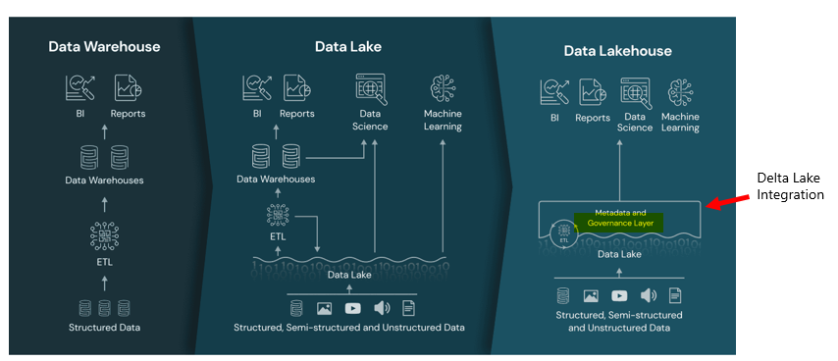
A data lakehouse is a modern data management architecture that combines the best features of data lakes and data warehouses. It provides the scalability and flexibility of data lakes with the data management and transactional capabilities of data warehouses
Key Features of a Data Lakehouse:
Scalability: Like data lakes, it can store vast amounts of structured, semi-structured, and unstructured data.
Data Management: It includes features like ACID transactions, schema enforcement, and data versioning, similar to data warehouses.
Unified Platform: It allows for both batch and real-time data processing, making it suitable for a wide range of analytics and machine learning tasks

